Slide 1

EMMI: Edge Multi-Modal Intelligence for Communication-Efficient MLLM Inference via Fused Representation Compression
Motahare Mounesan, Irfan Khan
Texas A&M University
ACM/IEEE Symposium on Edge Computing
Edge Intelligence 2026: The 3rd Workshop on Edge Intelligence
Notes:
Introduce the problem in one line: we want large multimodal model reasoning for edge devices that cannot run those models, over links that cannot carry raw sensor data. EMMI's answer is to change what crosses the link.

Slide 2
Outline
1
Introduction
Where edge MLLM inference breaks
2
Framework
System model and the EMMI pipeline
3
Solution
Cross-modal fusion and learned compression
4
Evaluation
Accuracy, latency, bandwidth regimes
5
Conclusion and Future work
Notes:
About fifteen seconds. Six parts: the problem through real examples, the framework, the two technical pieces, the numbers, the conclusion, and what comes next.

Slide 3
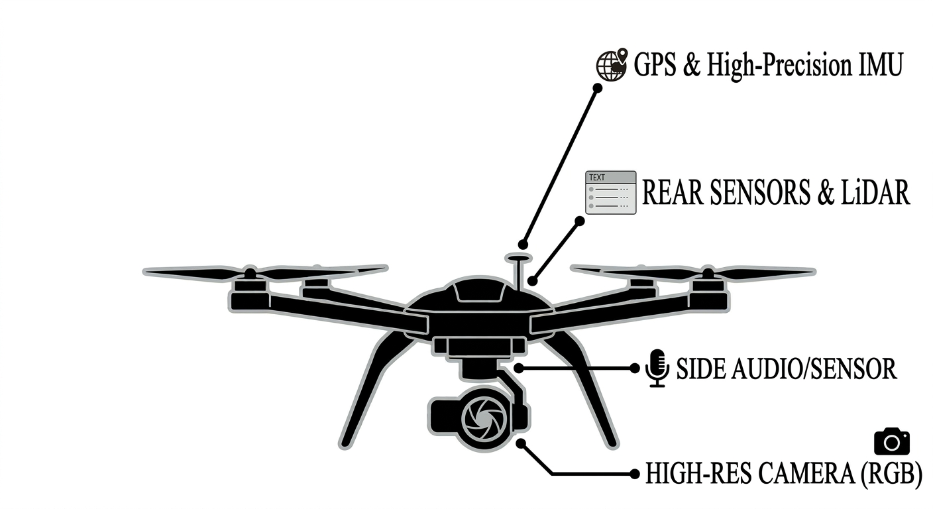
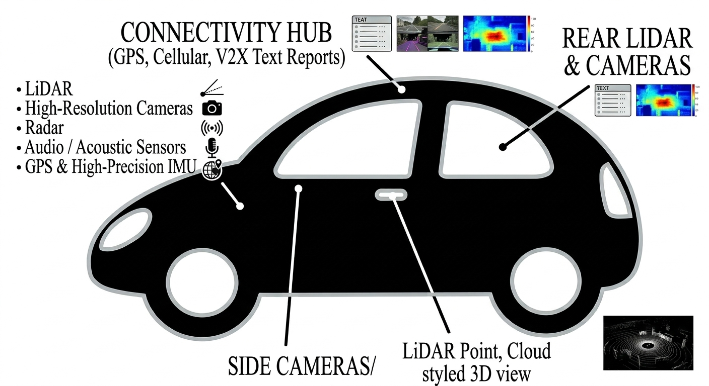
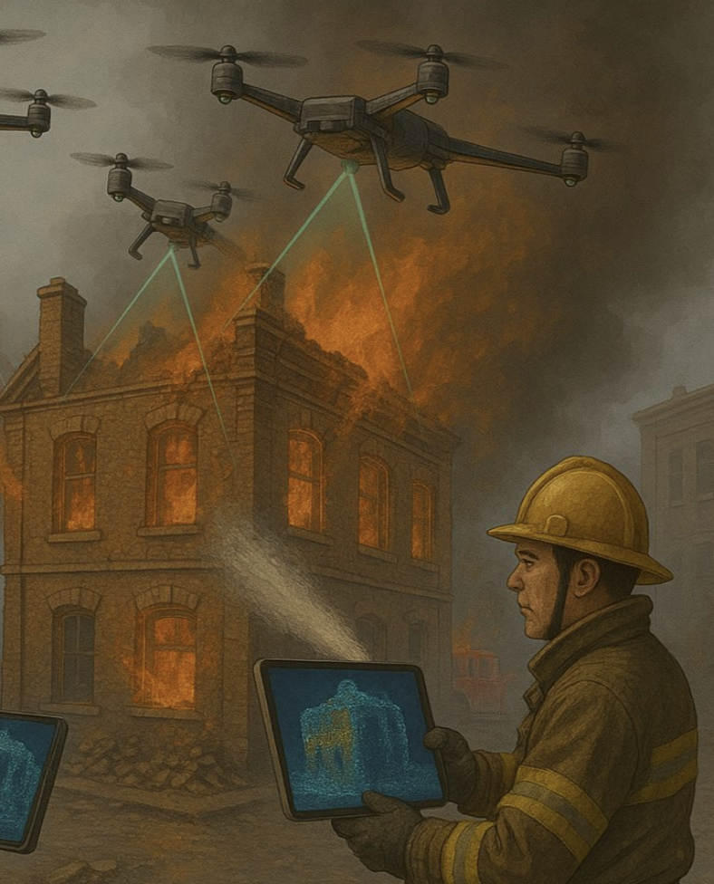
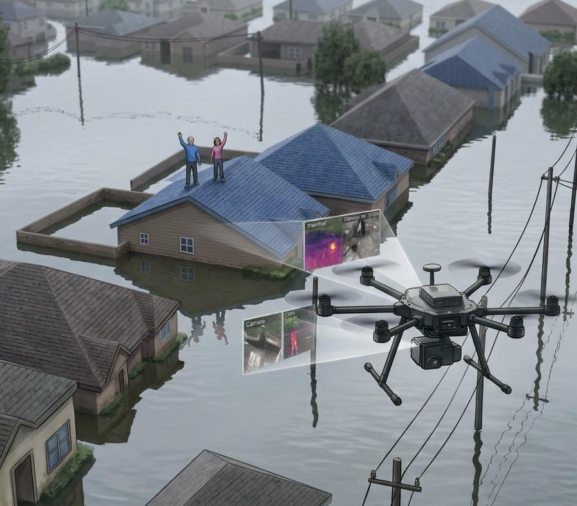
Why MLLM for edge?
Edge platforms sense through many modalities (RGB, thermal, LiDAR, GPS, text reports, audio, etc), and decisions need them interpreted together.
Task-specific AI
Multimodal LLM
One model, many tasks
New questions, new disasters
Reasoning
Detection, recognition by AI
Humans analyze, reason, decide
One model per task
Introduction
Framework
Solution
Evaluation
Conclusion
Future work
2
Notes:
Running example: disaster response. Top line: edge platforms now see heterogeneous sensor modalities, such as vision, text and telemetry; actionable insight requires interpreting them jointly. Left, task-specific AI [1]-[3]: AI does detection and recognition, for example drones scanning a burning building and giving firefighters a 3D map, but humans still analyze the output, reason about it and decide. And every task needs its own trained model, while a drone can carry only a few. Right, a multimodal LLM [4]-[6]: one model handles many tasks. Responders can ask new questions over time, first "is anyone on a roof?", later "is anyone near a downed power line?", and the same model can move to a new disaster, where needing help looks different, someone trapped under rubble after an earthquake. Our testbed is one building block: matching a field report to what the drone sees. The next slide shows why the MLLM cannot run on the drone or receive raw data. The examples are illustrative; MLLM generality comes from the literature, not from this paper's experiments.

Slide 4

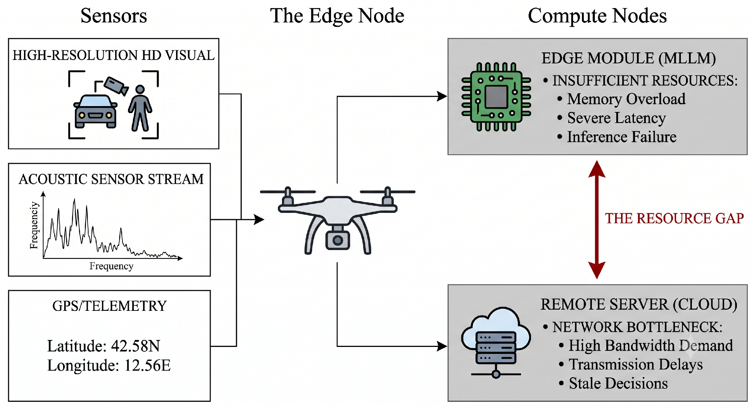


Why MLLMs are hard to bring to the edge?
On-board MLLM
Compute and memory
High-capacity MLLMs exceed edge resources; compact MLLMs give up reasoning capability.
Our server backbone alone: LLaVA-1.5-7B, 6.6B parameters
Limited bandwidth
Offloading over slow wireless links makes transmission the bottleneck.
Uncompressed: 655 of 903 ms is transmission at 0.1 Mbps
Offload raw data
Data exposure
Sending raw sensor observations exposes them over the network.
Raw data should ideally stay on the device
Introduction
Framework
Solution
Evaluation
Conclusion
Future work
3
Notes:
Use the drone as the running example. It carries a camera, an acoustic sensor and GPS. Running a full MLLM on board fails on memory and latency; shipping raw streams to the cloud fails on bandwidth and gives stale decisions. Compact on-device MLLMs (MobileVLM, TinyLLaVA) give up capability; split computing (EdgeShard, DistMLLM) ships architecture-dependent activations. EMMI's question is what the smallest useful payload is.

Slide 5
What should cross the edge–server boundary?
The MLLM must live on a server, so something has to cross the link. Each existing answer pays a cost.
OFFLOADING
SPLIT COMPUTING
FEATURE COMPRESSION
EMMI
Raw inputs
Model activations
Per-modality features
One fused, compressed latent
Every pixel and sample goes over the link.
The network is cut at a layer; its tensors cross.
Each modality compressed alone (e.g. TOFC).
Cost: bandwidth; raw data leaves the device.
Cost: tied to one model’s internals; frequent exchanges.
Modalities fused at the edge, then compressed.
Cost: fusion happens only after transmission.
Fixed size: 256 B, independent of the server model.
4
Introduction
Framework
Solution
Evaluation
Conclusion
Future work
4
Notes:
Three existing answers and their cost, then EMMI’s answer. This is the framing question for the whole talk.

Slide 6

System Model
Device i observes X_{i}^{t}: M_{i} modalities at time t
Device 1
RGB
GPS
wireless link · bandwidth B
Device i
thermal
LiDAR
text
Server
Device N
high-capacity MLLM
RGB
LiDAR
GPS
T_{edge}
T_{comm} = S_{tx} / B
T_{server}
edge processing
communication:
payload size over bandwidth
server reasoning
T_{total} = T_{edge} + T_{comm} + T_{server}
When B is small relative to payload, communication dominates.
The lever is the payload size S_{tx}: shrink it without losing task-relevant information.
Introduction
Framework
Solution
Evaluation
Conclusion
Future work
5
Notes:
Walk the top row left to right: N edge devices, each with a different sensor mix (device i observes M_i modalities at time t), a wireless link with bandwidth B, and a server hosting a high-capacity MLLM. Then the colored brackets underneath: edge processing, communication (payload size S_tx over bandwidth B), and server reasoning. Land on the bottom box: when B is small, communication dominates, so the lever is the payload size.

Slide 7
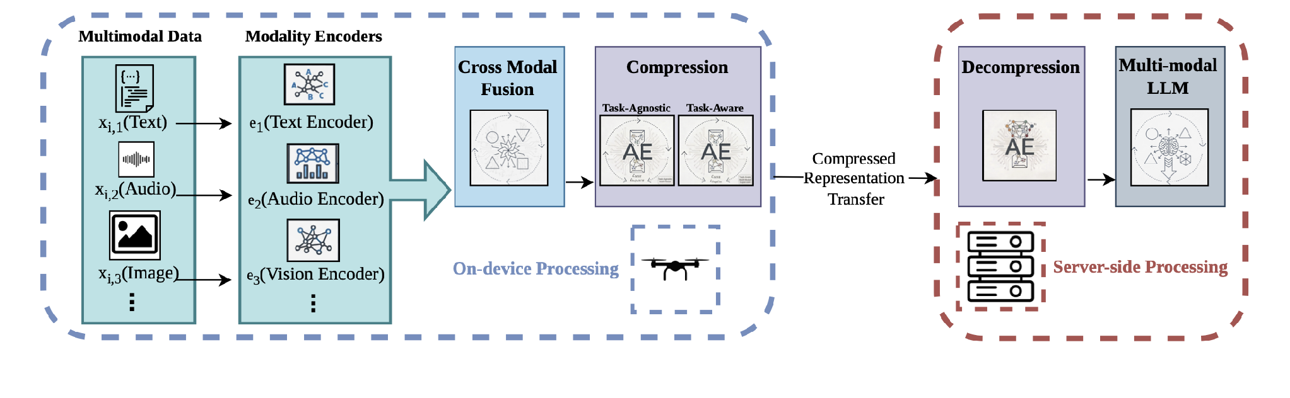
EMMI Framework
Light edge: Edge runs only encoders eₘ, fusion A(·) and compressor gφ; the MLLM stays on the server
Small payload: Only the latent z = gφ(f) crosses the link, with dim(z) ≪ dim(f) Link
Fixed interface: Same-size z from every device
Raw Data Local: Observations x stay on the device; only z leaves it
Introduction
Framework
Solution
Evaluation
Conclusion
Future work
6
Notes:
Walk the figure left to right. On the device: each modality has its own encoder, the embeddings are fused, then one autoencoder compresses the fused vector, task-agnostic or task-aware. Across the link: one fixed-size latent. On the server: decompress back to the fused space, project to soft tokens, run the frozen MLLM. Two design choices worth calling out. Fusion happens before compression, which is the difference from per-modality schemes. And decompressing before projection decouples the compressor from the reasoning module, so the compression ratio can change without retraining the LLM side. In the experiments only image and text are used; audio in the figure shows the general case.

Slide 8
Fuse explicitly, then compress
Cross-modal fusion
Difference: where modalities disagree.
Product: where they agree.
f =
h_{m}
h_{n}
|h_{m} − h_{n}|
h_{m} ⊙ h_{n}
each block d dims, so f has 4d
Autoencoder (AE) compression
Task-agnostic contrastive alignment objective
Trainable with alignment objectives
Decoder restores f, so the server is decoupled from the compressor
each sample is its own class: z stays close to its own image and caption embeddings
Task-aware supervised contrastive learning
AE loss
ℒ = ℒ_{rec}(d_{ψ}(z), f) + λ ℒ_{align}
Reconstruction loss
Alignment loss
each label is a class: z’s with the same label stay close
Introduction
Framework
Solution
Evaluation
Conclusion
Future work
7
Notes:
Left half first: the fused vector concatenates the two embeddings with their absolute difference and element-wise product. The difference shows where modalities disagree, the product where they agree; each block has d dims, so f has 4d. With more than two modalities, apply this to every pair and aggregate. Right half: the autoencoder is the compression. Its bottleneck z is much smaller than f, and the latent size sets the compression ratio; the encoder runs on the device, z is what crosses the link, and the decoder runs on the server. It is also trainable with alignment objectives, and its decoder restores f so the server stays decoupled from the compressor. The encoder g_phi maps f to the compact latent z and d_psi reconstructs it. The loss is reconstruction plus lambda times an alignment term, and the two modes differ only in that term: task-agnostic uses InfoNCE to align z with each modality embedding (no labels, reusable); task-aware uses supervised contrastive loss on labels (best accuracy). Labels are used only in training, so the deployed pipeline is identical.

Slide 9

Two system-level benefits
REPRESENTATION-CENTRIC DESIGN
1
Raw data stays on the device
2
Compression decoupled from reasoning
raw sensor data
only z
server
Compressor
any method / ratio
z
Decoder
to fused space
MLLM
unchanged
Only compact multimodal representations cross the edge–server link
Reduces exposure of raw sensor observations, while preserving the information server-side reasoning needs
Change the compression technique or ratio without retraining the MLLM
Reconstructed representations can be batched for parallel MLLM inference, amortizing cost across requests
Introduction
Framework
Solution
Evaluation
Conclusion
Future work
8
Notes:
Two benefits, exactly as in Section III-B. First, EMMI keeps raw sensor observations on the device: only compact multimodal representations cross the edge-server link, which reduces exposure of raw data while preserving what the server needs. Second, although the compressed latent could feed the MLLM directly, EMMI decompresses it back to the fused space first. That decouples compression from reasoning: different compression techniques or ratios can be used without modifying or retraining the reasoning module, and the reconstructed representations can be batched for parallel MLLM inference, amortizing its cost across requests.

Slide 10




Experimental setup
EVALUATION
Dataset and models
Compression (EMMI)
DATASET
MS-COCO Captions
PAYLOAD
8,192 B → 256 B
image + caption → match? · 72K / 5K / 5K
2,048-d → 64-d · 32× smaller
EDGE ENCODERS
CLIP ViT-B/32 (87M)
MobileCLIP2-S0 (11.4M)
METHODS
TaskAgnosticAE (InfoNCE)
TaskAwareAE (SupCon)
SERVER MLLM
LLaVA-1.5-7B, frozen
TRAINING, DECOUPLED IN TWO STAGES
SERVER HEAD
2-layer MLP → 8 soft tokens
STAGE 1
Encoders
AE
recon + alignment loss
+ binary classification head
STAGE 2
AE
cached z
MLP + head
LLaVA
trained
frozen
Baselines: same 64-d budget
Hardware and latency
REFERENCE
No compression
EDGE
1 x86 CPU thread (proxy)
UNSUPERVISED
PCA · BlockPCA · AE · VAE
SERVER
Quadro RTX 6000 GPU
SUPERVISED
LDA
TRANSMISSION
Estimated: payload ÷ bandwidth
0.1 / 10 / 50 / 100 Mbps
Introduction
Framework
Solution
Evaluation
Conclusion
Future work
9
Notes:
Four boxes. Dataset and models: MS-COCO captions as binary image-text matching, 72K/5K/5K; CLIP ViT-B/32 or MobileCLIP2-S0 on the edge; frozen LLaVA-1.5-7B on the server with a 2-layer MLP producing 8 soft tokens and a binary classification head. Compression: 8 KB fused vector to a 256-byte latent, 32x smaller, with our two autoencoders. Training is decoupled: stage 1 trains only the autoencoder, with encoders frozen; stage 2 freezes the autoencoder, caches its latents, and trains only the MLP and head, with LLaVA frozen. The MLLM is never retrained. Baselines: no compression, PCA, BlockPCA, AE, VAE and LDA, all at the same 64 dimensions. Hardware: the edge is approximated by one x86 CPU thread, the server is a Quadro RTX 6000 GPU, and transmission time is computed as payload over bandwidth at four link speeds, so end-to-end latency is estimated.

Slide 11
Same 32× compression, accuracy from 52% to 98%
ACCURACY EVALUATION
Test accuracy (%) · change from uncompressed in grey
SAME FOR EVERY METHOD
CLIP ViT-B/32
MobileCLIP2-S0
Fused 2,048-d → 64-d: 32× smaller, 8,192 B → 256 B
87M · full-size
11.4M · compact
REFERENCE
EDGE ENCODERS
No compression
97.9
98.4
CLIP ViT-B/32 (87M): the standard full-size CLIP image encoder
UNSUPERVISED
MobileCLIP2-S0 (11.4M): ~8× smaller, distilled for on-device speed
PCA
96.9 −1.0
57.4 −41
Autoencoder
93.4 −4.5
52.0 −46
Both give 512-d image and text embeddings
VAE
96.8 −1.2
69.9 −29
BASELINES
BlockPCA
97.1 −0.8
97.8 −0.6
PCA: keeps the 64 highest-variance directions of the fused vector
SUPERVISED
BlockPCA: PCA on each fused block separately
LDA
97.8 −0.1
98.3 −0.1
EMMI (OURS)
AE / VAE: learned encoder–decoder, trained only to reconstruct
TaskAgnosticAE
94.1 −3.8
90.3 −8
LDA: supervised linear projection that best separates match from no-match
TaskAwareAE
98.1 +0.2
98.3 −0.1
OBSERVATION 1
OBSERVATION 2
Compression can preserve accuracy
The small encoder is sensitive
TaskAwareAE stays within 0.1 pt of uncompressed, 32× smaller.
PCA, AE and VAE lose 29–46 pt on MobileCLIP, at most 4.5 on CLIP.
Notes:
Left side, what we compare. Two edge encoders: standard CLIP ViT-B/32, and MobileCLIP2-S0, about eight times smaller and distilled for on-device speed; both give 512-dimensional embeddings. Baselines: PCA keeps the highest-variance directions of the fused vector; BlockPCA runs PCA on each fused block separately; a plain autoencoder and a VAE learn to reconstruct; LDA is a supervised linear projection that separates match from no-match. Every method compresses to the same 64 dimensions, 32 times smaller. Right side, the results. Uncompressed, both encoders are about 98 percent. On MobileCLIP, PCA, a plain autoencoder and a VAE drop 41, 46 and 29 points; on CLIP they lose at most 4.5. BlockPCA and LDA stay within 0.6 points. Our task-aware autoencoder is within 0.1 points of uncompressed; the label-free version reaches 90.3. Next slide: what this means.

Slide 12
Same 32× compression, accuracy from 52% to 98%
ACCURACY EVALUATION
MobileCLIP2-S0 · accuracy (%) at 64-d
Why is the small encoder sensitive? hypotheses, untested
REFERENCE
1
What goes wrong: PCA, AE and VAE keep what varies most
No compression
98.4
The match signal likely sits in the difference and product blocks. A per-block budget (BlockPCA) or a task objective (LDA, TaskAwareAE) keeps it.
UNSUPERVISED
PCA
57.4
2
Encoder geometry: MobileCLIP may distribute information differently
Autoencoder
52.0
Plausible, but the hardest to show. Test: per-block variance and PCA spectra for both encoders.
VAE
69.9
BlockPCA
97.8
Why EMMI's AE over LDA and BlockPCA? expected
SUPERVISED
1
TaskAwareAE vs LDA: tied at 98.3
LDA
98.3
LDA keeps only what separates the labels; the AE is trained to rebuild the full vector, so the MLLM gets content for open-ended tasks.
EMMI (OURS)
TaskAgnosticAE
90.3
2
TaskAgnosticAE vs BlockPCA: BlockPCA wins here (97.8 vs 90.3)
TaskAwareAE
98.3
Both are label-free. The AE can be trained with alignment objectives and may adopt better as modalities grow.
On CLIP, every method loses at most 4.5 pt
Introduction
Framework
Solution
Evaluation
Conclusion
Future work
11
Notes:
Two questions. First, why is the small encoder so sensitive? MobileCLIP is slightly better uncompressed, so the information is there; only PCA, the plain autoencoder and the VAE lose it. Our hypothesis: these methods keep what varies most, and the match signal likely sits in the difference and product blocks of the fused vector. Two things keep it: a per-block budget, as in BlockPCA, or an objective that targets the task, as in LDA and our task-aware autoencoder, which compresses the whole vector but is told what matters. The label-free autoencoder, guided only by InfoNCE alignment, lands in between. Why only MobileCLIP? One possibility is encoder geometry: the compact encoder may genuinely distribute information differently from CLIP. That is plausible but the hardest to show; per-block variance and PCA spectra for both encoders would tell us. Second, why use our autoencoder rather than LDA or BlockPCA? Against LDA, the task-aware autoencoder is tied, but LDA keeps only what separates the labels, while the autoencoder is trained to rebuild the full vector, so the MLLM gets content for open-ended tasks. Against BlockPCA, the label-free comparison, BlockPCA wins on this task, and we say so; the autoencoder can be trained with alignment objectives and is not tied to a fixed block split as modalities grow. These are expected advantages that we still need to test.

Slide 13
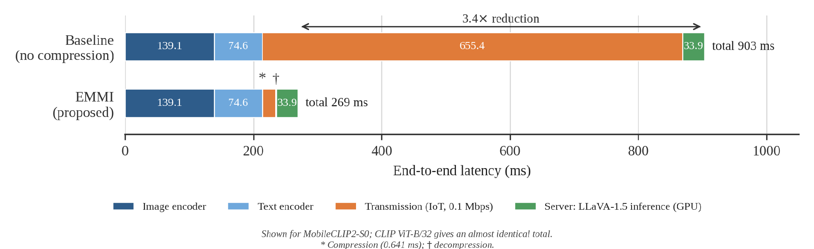
32× smaller payload, 3.4× lower latency on a slow link
COMMUNICATION EVALUATION
Payload 8,192 B → 256 B. Compute is measured (edge: 1 CPU thread proxy; server: RTX 6000); transmission is payload ÷ bandwidth, so totals are estimated.
OBSERVATION 1
OBSERVATION 2
On a slow link, the payload dominates
The bottleneck shifts to the encoders
Transmission is ~73% of uncompressed latency; EMMI cuts it from 655 to 20 ms.
With EMMI, encoding (214 ms) is now most of the latency, and compression adds only 0.64 ms.
Introduction
Framework
Solution
Evaluation
Conclusion
Future work
12
Notes:
Now communication. This is the paper's Figure 2: estimated end-to-end latency on a 0.1 megabit IoT link with MobileCLIP. Without compression, each inference sends the 8-kilobyte fused vector, and transmission alone is 655 milliseconds, about 73 percent of the 903 total. EMMI sends 256 bytes, so transmission drops to 20 milliseconds, and compression adds only 0.64. Total: 269 milliseconds, 3.4 times lower. Notice what remains: the image and text encoders, 214 milliseconds, are now most of the latency, so the bottleneck has shifted from the link to edge compute. These are estimates: compute is measured, transmission is computed from payload and bandwidth.

Slide 14
32× smaller payload, 3.4× lower latency on a slow link
COMMUNICATION EVALUATION
Transmission time saved · ms per inference
TAKEAWAYS
IoT
635
Faster uplinks shrink the latency gain
0.1 Mbps
Time saved falls as 1/bandwidth: 635 ms at 0.1 Mbps, 6 ms on LTE, break-even near 100 Mbps.
LTE
6.35
10 Mbps
More modalities should make it matter more expected
WiFi
Uncompressed payloads grow with every added sensor (RGB, thermal, LiDAR, GPS, text), so the gain from compressing at the edge should grow too.
50 Mbps
1.27
5G
0.63
Many devices sharing one link or server expected
100 Mbps
A shared 10 Mbps uplink carries ~150 inferences/s at 8 KB, but ~4,900/s at 256 B.
Edge cost of fusion + compression: 0.65 ms, vs 213.7 ms of encoding (Table II)
Introduction
Framework
Solution
Evaluation
Conclusion
Future work
13
Notes:
Four takeaways on communication. First, the latency gain shrinks as the uplink gets faster: the time saved falls as one over bandwidth, 635 milliseconds on the IoT link, about 6 on LTE, and around 100 megabits per second it breaks even with the 0.64 millisecond compression cost. Second, and we have not tested this: with more modalities the benefit should grow, because uncompressed payloads grow with every added sensor, such as RGB, thermal, LiDAR, GPS or text reports. How large the latent must be for more modalities is an open question. Third, many devices often share one uplink or one server: a shared 10 megabit link carries about 150 inferences per second at 8 kilobytes, but about 4,900 at 256 bytes. Fourth, each device sends a fixed-size latent, which gives the server an interface it can batch. The last three are expected benefits; multi-device batching is our next experiment.

Slide 15
Conclusion and Future work
We propose EMMI to bring MLLM reasoning to edge devices. EMMI shifts the communication from raw data or intermediate activations to a single fused, compressed latent. On a simple task:
32× smaller payload (8,192 B → 256 B) at ≈ uncompressed accuracy (98.32% vs 98.41%)
3.4× lower estimated end-to-end latency on a 0.1 Mbps link
Future directions:
More modalities and heterogeneous devices: beyond image and text
Open-ended MLLM tasks: beyond binary image–text matching e.g. audio-visual QA
Non-aligned encoders: modalities outside CLIP's shared space need modality alignment
Real edge hardware: move from a CPU proxy to embedded NVIDIA boards
Multiple edge devices: many devices sharing one server, measuring the latency and throughput gains of batching
Introduction
Framework
Solution
Evaluation
Conclusion
Future work
14
Notes:
Close on the three points. On point 2, the numbers are 98.08 and 98.32 against 97.92 and 98.41 uncompressed. If time is short, skip the fusion-details slide and the setup slide; the story still holds.

Slide 16
Thank you!
email me at motahare@tamu.edu
Notes:
Leave this up during questions. If a question is about evaluation scope, jump back to the future-work slide; if it is about baselines, jump to the accuracy slide.

